Slide 1
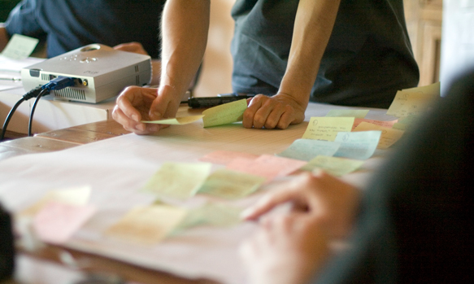
http://flic.kr/p/6sdZDR
Software Requirements

Slide 2
SWEBOK Knowledge Areas
Today’s topic
Software Requirements
Software Design
Software Construction
Software Testing
Software Maintenance
Software Configuration Management
Software Engineering Management
Software Engineering Process
Software Engineering Models and Methods
Software Quality
Software Engineering Professional Practice
Software Engineering Economics
Computing Foundations
Mathematical Foundations
Engineering Foundations

Slide 3
Recall what customers want...
Software that
Meets their needs,
On time,
and
On budget
Requirements!

Slide 4
Software Requirements
"express the needs and constraints placed on a software product that contribute to the solution of some real-world problem"
Source: SWEBOK Version 3.0

Slide 5
Requirements Problems
Missing requirements
Incorrect requirements
Ambiguous requirements
Conflicting requirements
Untestable requirements
Changing requirements
Being overwhelmed by scale ("bag of leaves")
Loss of traceability

Slide 6
Software Requirements SWEBOK Knowledge Area
Elicitation: Where to get them, how to gather
Analysis: Categorizing, modeling, resolving conflicts
Specification: Documenting
Validation: Checking correctness
Management: Coping with change, traceability
Source: SWEBOK Version 3.0

Slide 7
Types of Requirements
Functional: "functions that the software is to execute"
AKA capabilities or features
Non-functional: "act to constrain the solution"
AKA constraints or quality requirements
Source: SWEBOK Version 3.0

Slide 8
FURPS Classification
Functional: features, capabilities, security
Usability: human factors, help, documentation
Reliability: frequency of failure, recoverability, predictability
Performance: response times, throughput, accuracy, availability, resource usage
Supportability: adaptability, maintainability, internationalization, configurability
Non-functional requirements
AKA the "-ilities"

Slide 9
Two Key Problems for Today
Figure out what features the customer wants
Not make false/incorrect assumptions
Chunk work into bite-sized pieces
So work can be divided up
So system can be built incrementally
So estimates are remotely accurate

Slide 10
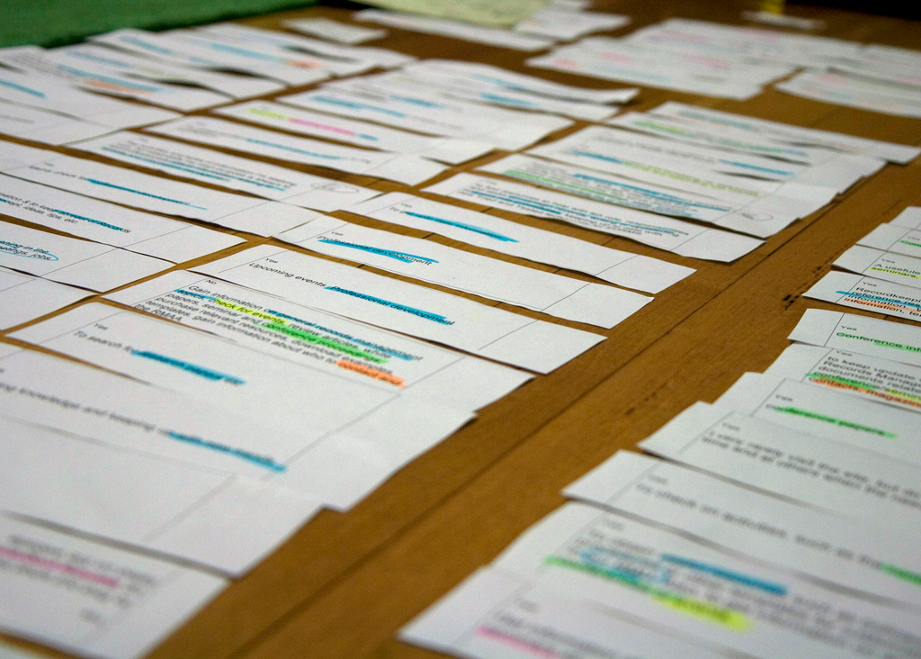
User Stories (USs)
“... a chunk of functionality (some people use the
word feature) that is of value to the customer.”
http://flic.kr/p/884GBP
Source: Kent Beck & Martin Fowler, Planning Extreme Programming

Slide 11
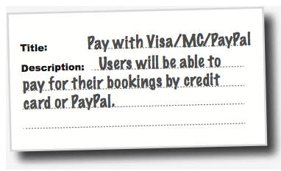
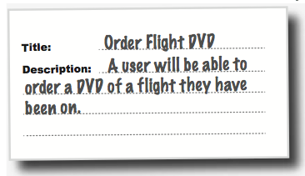
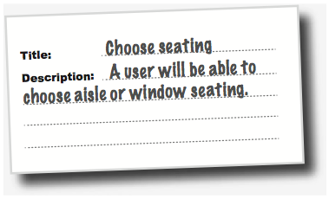
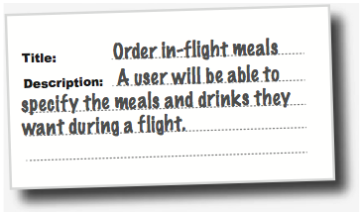
Flight-Booking System Example
Two parts: title and description

Slide 12
US Description Template
As a <who>, I want <what> so that <why>.
Examples
As a user, I want to backup my entire hard drive so that I won't lose data if my system breaks.
As an Editor, I want to review content before it is published so that I can assure it is optimized with correct grammar and tone.
As a Content Owner, I want to be able to create product content so that I can provide information and market to customers.

Slide 13
Description Examples: Who and What

Slide 14
US Title Template: Verb + Noun

Slide 15
User Story Dos & Don’ts
Do... | Don't...
Describe one thing that the software needs to do for the customer | Include what essentially amount to groups of features (even if all are related)
Use language that the customer understands | Use technical terms that are unfamiliar to the customer
Ensure "written by the customer" (at least figuratively speaking) | Invent requirements that the customer never actually asked for
Keep short – generally no more than three sentences | Write a long essay
Capture only requirements (not design) | Mention specific implementation technologies or user-interface elements
Principle: Keep requirements customer-oriented

Slide 16

Summary
Requirements problems
Requirements types
User stories
US title and description templates
Qualities of good USs
http://flic.kr/p/aCLor3

Slide 17
Appendix

Slide 18
Let’s write some user stories!
Title: <verb> <noun>
Description: As a <who>, I want <what> so that <why>.

Slide 19
Web App for Bicycle Rental

